Slide 1

Git Lecture-2
www.corvit.com

Slide 2
Topics
Initiating Repository
Workflow
Commit
Removing/Renaming Files
.gitignore
Short Status
Viewing Staged and Unstaged Changes
Viewing History
Unstaging Files
Deleting Commits
Discarding Local Changes
Restoring File to an Earlier Version
www.corvit.com

Slide 3
Initializing A Repository
git init
ls -a
rm -rf .git
www.corvit.com

Slide 4

Workflow
Snapshot : Git project have a git repository which is actually a hidden sub-directory, it stores the commits made to the project. Git commit is just like a snapshot, we make changes to different files and then we commit those changes so basically a snapshot is taken and is saved in that repository.
www.corvit.com

Slide 5

Workflow
Staging: Staging Area or Index is a special place which resides between project and the hidden git repository. This feature is only available in git. When we are done making changes to our files, instead of directly committing them to repository we push them to staging area for review. If the changes made are fine then we commit them and the snapshot is saved in the repository otherwise we unstage the changes and push another snapshot to the repo.
www.corvit.com

Slide 6
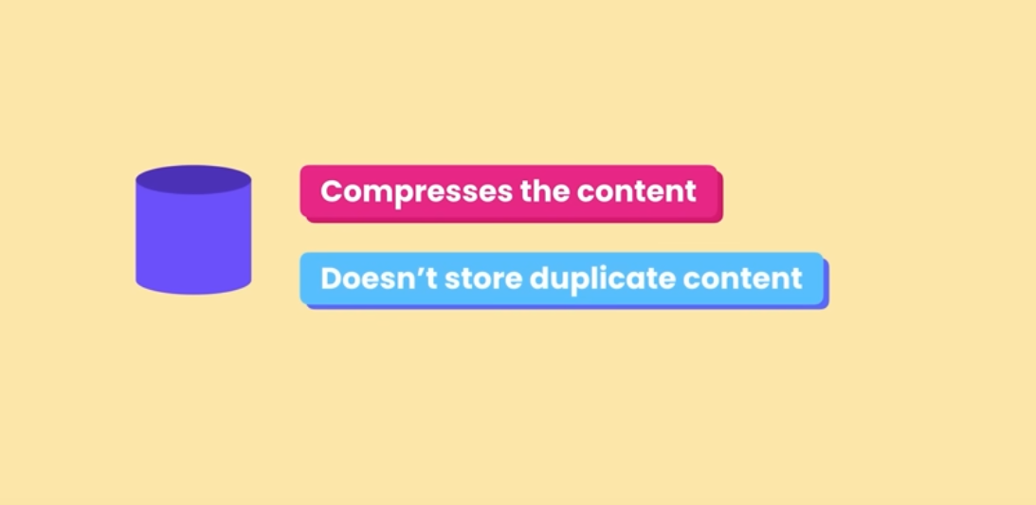
www.corvit.com

Slide 7
Example
Create file1.txt and file2.txt in the project
git add file1.txt and file2.txt
git status
git ls-files (to check which files are there in staging area)
git commit -m “1st commit”
git status
Make change to file1
git add file1.txt
git commit –m “2nd commit”
Delete file2
git add file2.txt (this will remove file2 from staging area)
git commit -m “3rd commit” (this will remove file2 from 3rd snapshot in the repo)
Note: Red is for upstaged changes and green is for staged
git commit -a -m “this will skip the staging area, not recommended”
www.corvit.com

Slide 8
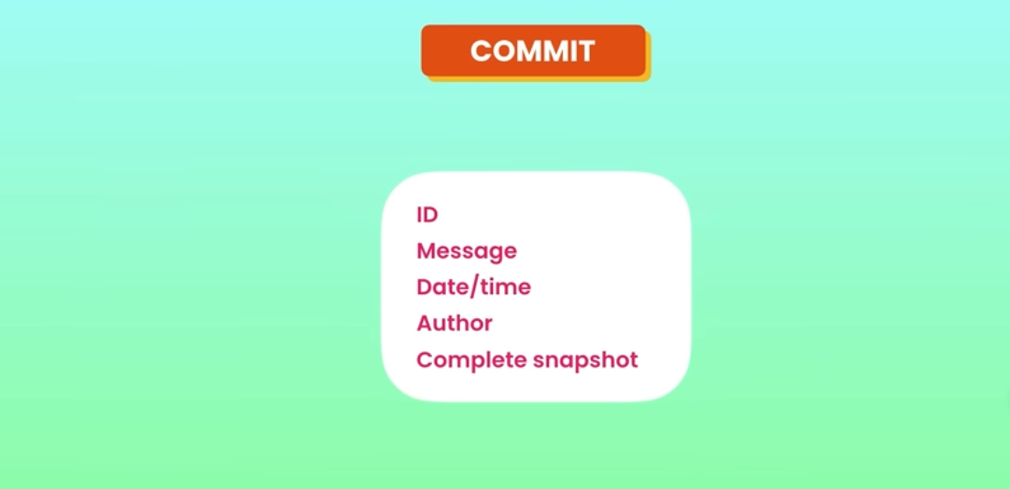
www.corvit.com

Slide 9
Committing Best Practices
Don’t commit very few or too much changes in a single commit
Commit a single unit of work. A bug fix and a typo should be two different commits.
Use meaningful commit messages so that anyone can find the commit easily from the history.
www.corvit.com

Slide 10
Removing/Renaming Files
To remove a file we need to delete it from our working directory and staging area. rm file.txt git add file.txt instead we can use git rm file.txt which removes file from both places. Afterwards we can commit the changes. git rm --cached -r file1.txt (this will remove file1 from staging area but not from working directory)
For renaming mv file.txt filenew.txt git status (file.txt would be unstaged and filenew.txt would be untracked.) git ls-files git add file.txt filenew.txt (to stage both files) instead we can use git mv file.txt filenew.txt
www.corvit.com

Slide 11
.Gitignore
.gitingore is the file which contains all files and other stuff which we need to ignore. This should be created at root of your project. This file doesn’t have any name just have extension.
code .gitignore (to open gitignore file in VS code)
git add .gitignore
folder/ (to add a complete directory in gitignore) file.txt (to add a file ) *.log (all log files)
Add a file to gitignore before committing it because it would not be ignored as it would be in staged area. To ignore this kind of file first remove file from staged area, add to gitignore and then commit.
https://github.com/github/gitignore you can find different gitignore templates for different programming languages at this link.
www.corvit.com

Slide 12
Short Status
git status command shows a detailed status instead of that we can use git status -s which shows a short meaningful status.
Example: create file1 and file2. git status -s git add file1 git status -s make changes to file1 git status -s add file1 git status -s make another change to file1 git status –s git add file1 file2 git status -s
www.corvit.com

Slide 13
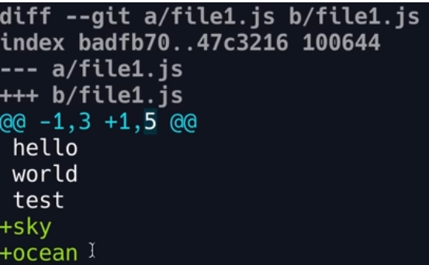
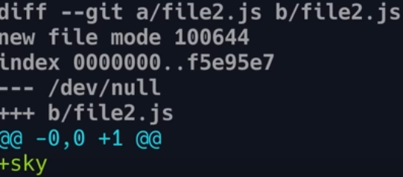
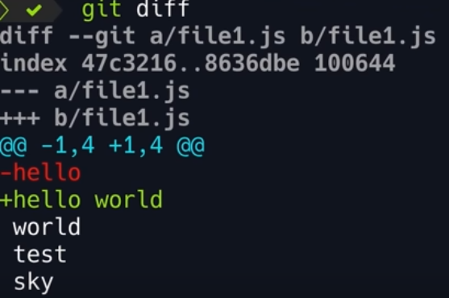
Viewing Staged and Unstaged Changes
git status just shows which files are modified but not the real content which is modified, for that we use “diff” command.
git diff (shows unstaged changes)
git diff --staged (shows changes between last commit and current staging area.)
- represents old + represents new
Red color represents removal Green color represents addition
@@ -1,3 +1,5 @@ -1,3 section is showing details for old copy means from line 1, 3 objects are extracted. +1,5 section shows the new copy is in staging area means from line 1, 5 objects are extracted. 2 of them are the changes added to the file.
www.corvit.com

Slide 14
Visual Diff Tools
VS Code
KDiff3
P4Merge
WinMerge (Windows only)
www.corvit.com

Slide 15
Viewing History
git log (this commands shows the history of the commits made to repo)
Default sorting order is latest to the oldest. Press space to scroll down. Press q to quit.
git log --oneline (shows the summary of the commits instead of detailed description of the commit)
git log --oneline --reverse (reverse the sort order)
www.corvit.com

Slide 16
Viewing Commits
git show <unique identifier of commit> (shows the changes in the commit)
git show HEAD (shows the latest commit) git show HEAD~1 (shows commit before the latest. You can increase the num and see the previous commits).
git show HEAD~1:file.txt (to see the final version of the file not the differences)
git ls-tree HEAD~1 (shows the files and directories in a commit) note: blob represents the files, tree represents directories.
www.corvit.com

Slide 17
Unstaging Files
If you had made changes to a file and added it to staging area you can unstage those changes without deleting the file.
git restore --staged file.txt
This command would restore file.txt from the latest snapshot committed to the repository.
www.corvit.com

Slide 18
Deleting Commits
git reset <commit id>
this would unstage all the changes made in the commits which were pushed after the commit you are resetting to.
www.corvit.com

Slide 19
Discarding Local Changes
git restore . (this would undo all local changes made by you and replaces everything except untracked files with latest snapshot)
git clean -f -d (use to clean untracked files) note: -f is used to forcefully perform the operation, -d is used to clean the directories.
www.corvit.com

Slide 20
Restoring File to an Earlier Version
git restore --source=HEAD~1 file.txt (restore file from previous commit)
By reverting the commit
www.corvit.com

